Slide 1

RESUME PARSING USING NLP (SpaCy NER)
GROUP 1
SIDDHARTHA PATRA (0787887) USAMA NORAT (0792225) AMIR DAHYA (0791252)

Slide 2

INTRODUCTION
This project aims to simplify and streamline the resume screening process by building a resume parser application using Natural Language Processing, specifically using the Spacy NER (Named Entity Recognition) framework.

Slide 3
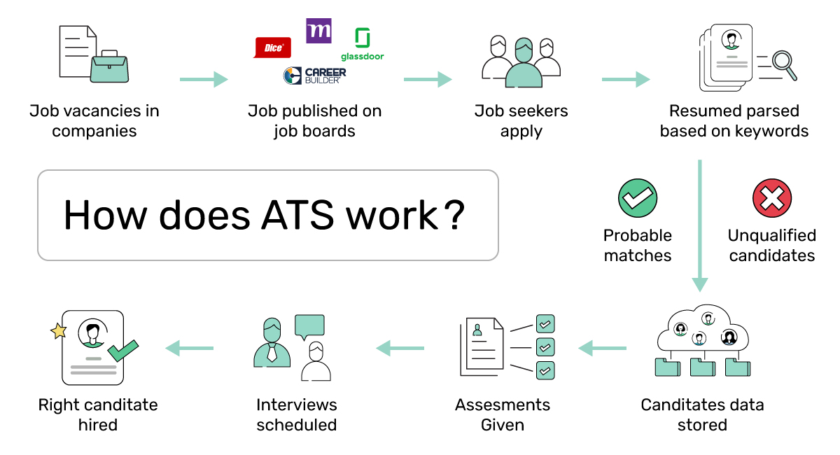
CURRENT STATE OF AFFAIRS: ATS SYSTEM

Slide 4



BUSINESS PROBLEM
TIME
COST
HUMAN ERROR
NEED FOR AUTOMATION
Through this project we aim to automate the process of resume screening and shortlisting using Natural Language Processing techniques to extract relevant information from resumes and categorize them based on job requirements, with the goal of helping recruiters identify suitable candidates more quickly, cost-effectively and free from human error.

Slide 5












WHAT IS NAMED ENTITY RECOGNITION?
Work Experience
Name
E-mail
Location
NER
Education
Designation
Skills
Degree

Slide 6

WHY SpaCy FRAMEWORK?
PRE-TRAINED MODELS
SpaCy
SPEED
CUSTOM-IZATION

Slide 7














PROJECT DATA FLOW
DATA COLLECTION & PRE-PROCESSING
MACHINE LEARNING PIPELINE
CLOUD-BASED MODEL DEPLOYMENT

Slide 8
DATA COLLECTION & PRE-PROCESSING

Slide 9
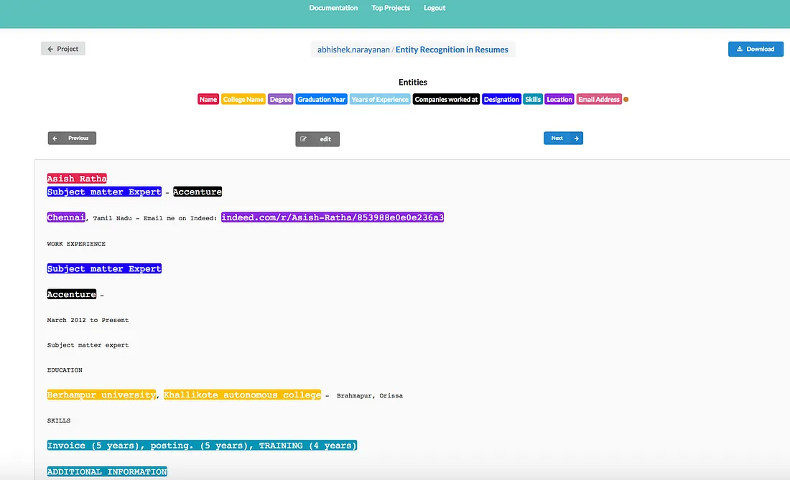

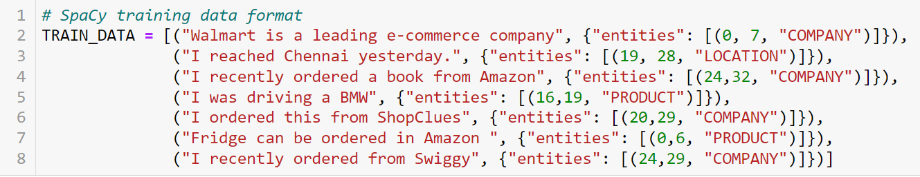
DATA COLLECTION & PRE-PROCESSING
2. Dataturks Annotation Tool
1. Data Collection: 220+ Resumes from LinkedIn
3. Post-Annotation Training Data
4. SpaCy Input Format

Slide 10
MACHINE LEARNING PIPELINE

Slide 11

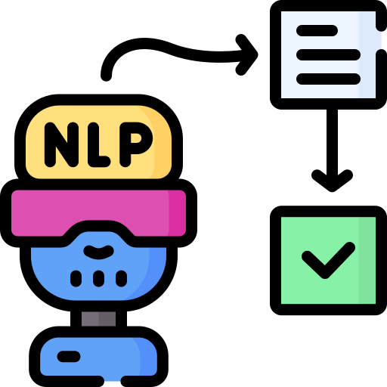




MACHINE LEARNING PIPELINE
Convert JSON Data to Spacy format
Train SpaCy Model
Text Extractor
Check Existing Model
Predict using
SpaCy Model
Check Model Accuracy

Slide 12
CLOUD-BASED MODEL DEPLOYMENT

Slide 13
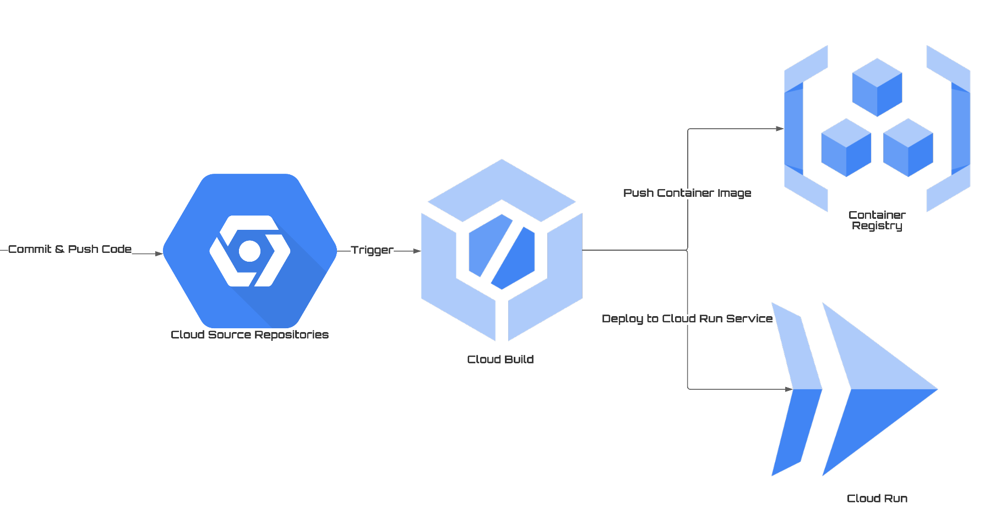

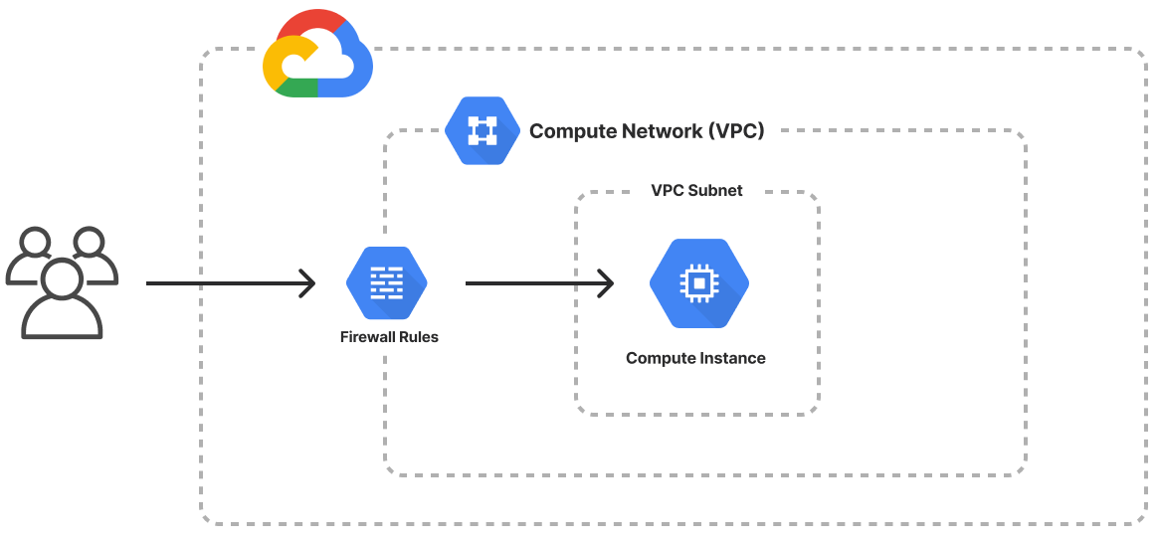
GOOGLE CLOUD DEPLOYMENT
Web-Based Streamlit Application

Slide 14
PRODUCT DEMO
http://34.125.178.148:8501
GitHub Link to Source Code:
https://github.com/Capstone-Resume-Parser-Group1/Capstone-Resume-Parser-Group1

Slide 15
WAY FORWARD
For Recruiters
Entity based candidate filtering
For Job-Seekers
Entity based job recommendation

Slide 16

Thank You!
Siddhartha Patra (0787887)
Usama Norat (079225)
Amir Dahya (0791252)

Slide 17
REFERENCES
https://analyticsindiamag.com/dataturks/
https://spacy.io/usage/spacy-101
https://www.tutorialspoint.com/tika/index.htm
https://towardsdatascience.com/a-review-of-named-entity-recognition-ner-using-automatic-summarization-of-resumes-5248a75de175
https://github.com/DataTurks-Engg/Entity-Recognition-In-Resumes-SpaCy
https://medium.com/@debanjanmahata85/natural-language-processing-with-spacy-36b90b9afa3d
https://www.digitalocean.com/community/tutorials/how-to-install-and-use-docker-on-ubuntu-18-04
https://cloud.google.com/docs/get-started
Special thanks to all the people who made and released these great resources for free:
Presentation template by SlidesCarnival
Photographs by Unsplash
Icons by Flaticon

